Slide 1
QURAN EXPLORER
Abdul Moiz Siraj (14818) | Fatima Altaf Hussain(14139)

Slide 2
Why the Quran Explorer?
1
Quick Access to Authentic Quran,
Easy, On the Go,
In-depth research options:
English and Urdu Translations.
Searching using Ayats, Surahs, Topics and Subtopics.

Slide 3
Application
2
Referencing Quran on various occasions,
Personal Use,
School and Madrasas,

Slide 4

Components
Arabic, English and Urdu Text Files
CLASSES HashTable, Project, Quran, Topic
FRAMES mainScreen, topicScreen, surahScreen.

Slide 5
Data Structure Demonstration

Slide 6
Why Hashing?
3
Array based -> allows direct access
Average case - Constant time access for insertion and searching.
LINEAR HASHING - similar ascii codes are saved in chuncks makes searching faster
Used weights for character positions to minimize collisions.
Avoid problems like degenerated trees.
Length : (n+1/3n) and prime number.

Slide 7

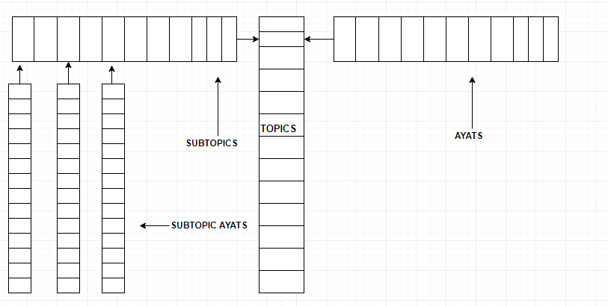

Slide 8
BigO
Function
Search Surah | O(n) | N= no of ayah
Search Ayah | O(1) | Constant
Search Topic | O(c + n) | Constant & N= no of ayah
Search Subtopic | O(c + n) | Constant & N= no of ayah

Slide 9
Data Source
Quranic Verses and Translations : data was in a csv file where 6000+ ayahs of the Quran were saved sequentially. Ayahs for each surah were saved into separate file making a total of 114 files.
Topics and related verses: a topic wise distribution of verses was copied in raw form from the website: https://www.searchtruth.com/quran_topics_index.php#, the data was then formatted so that is could be parsed in the program.
Pictures for both before and after formatting of the data provided on the next slide for better understanding

Slide 10
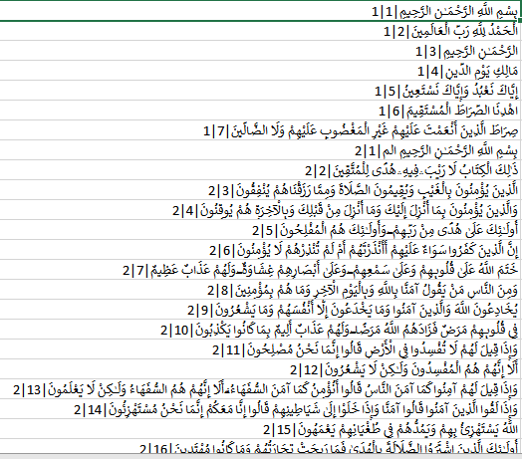
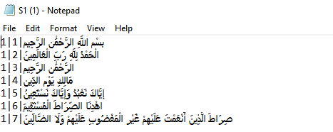
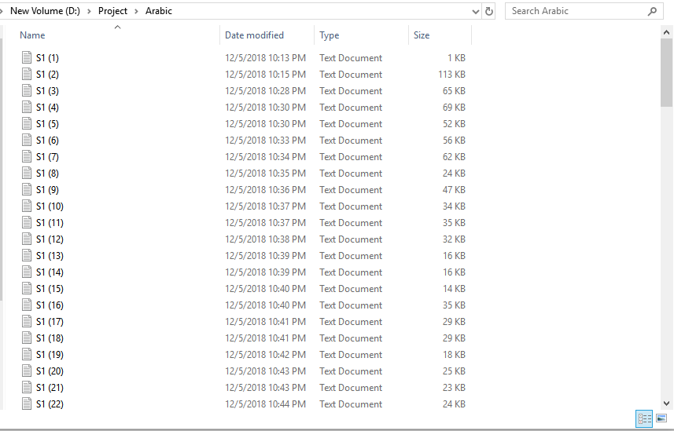
Quranic Verses

Slide 11
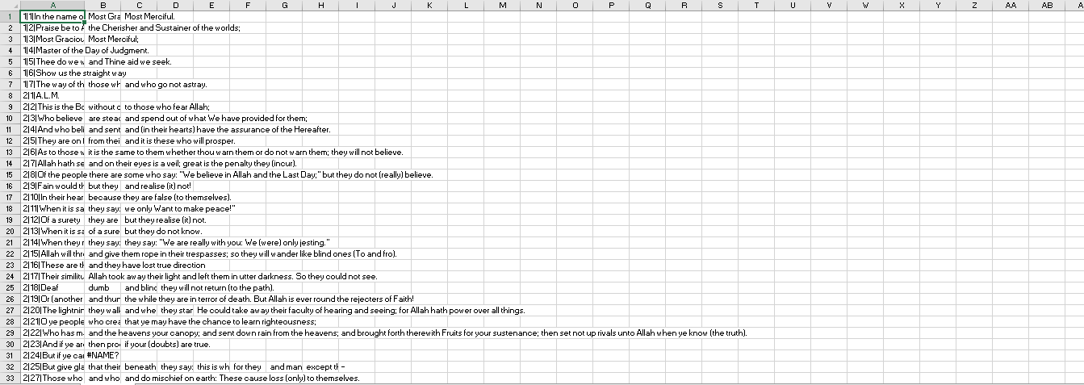
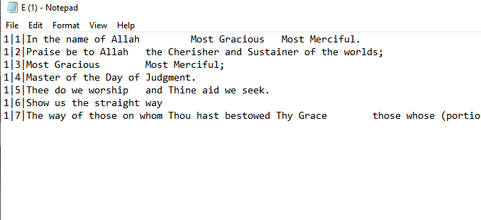
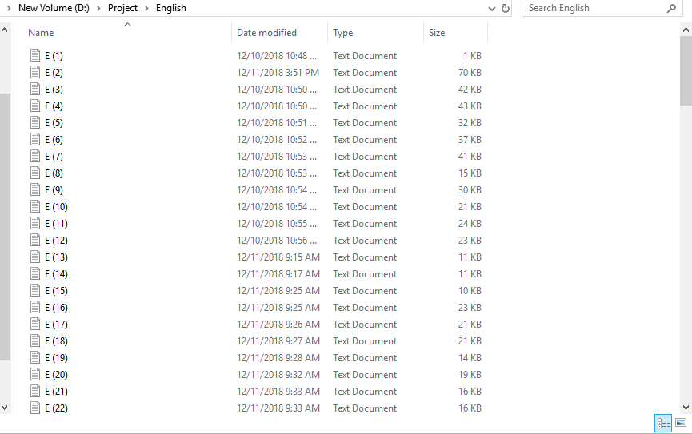
English Translation

Slide 12
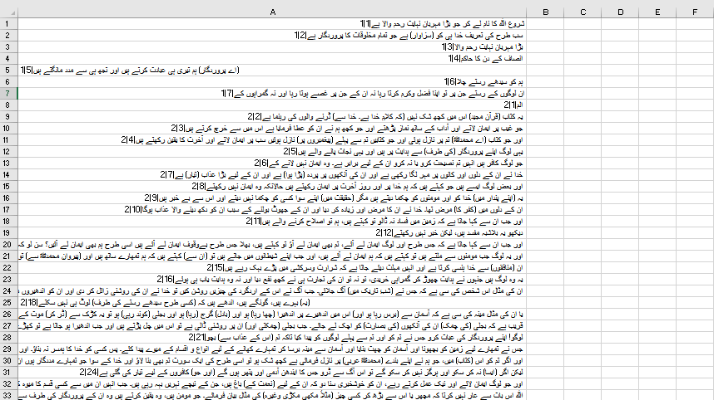
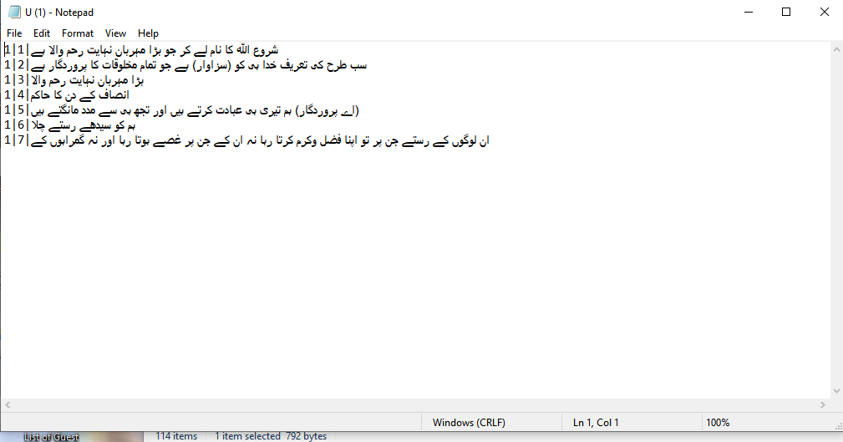
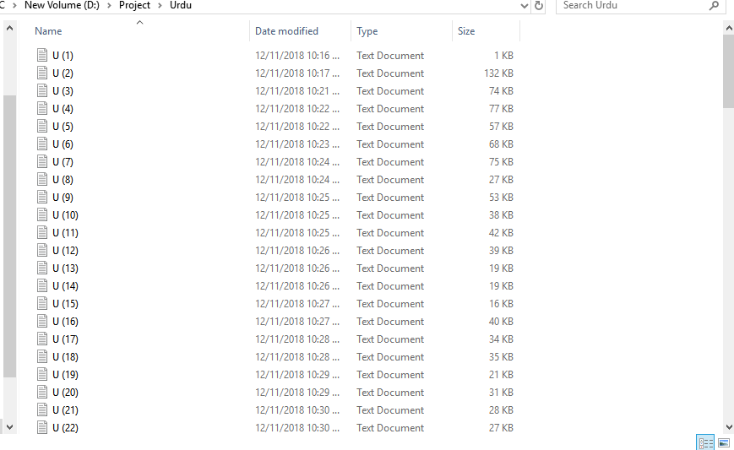
Urdu Translation

Slide 13
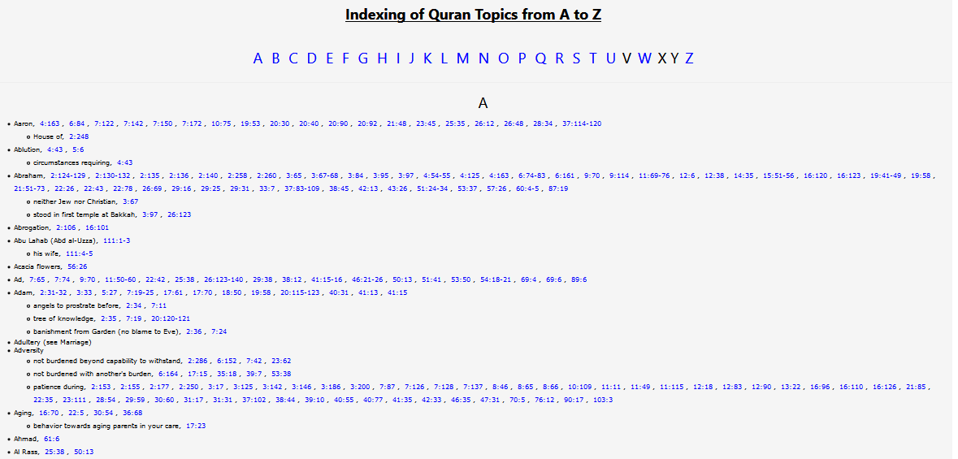
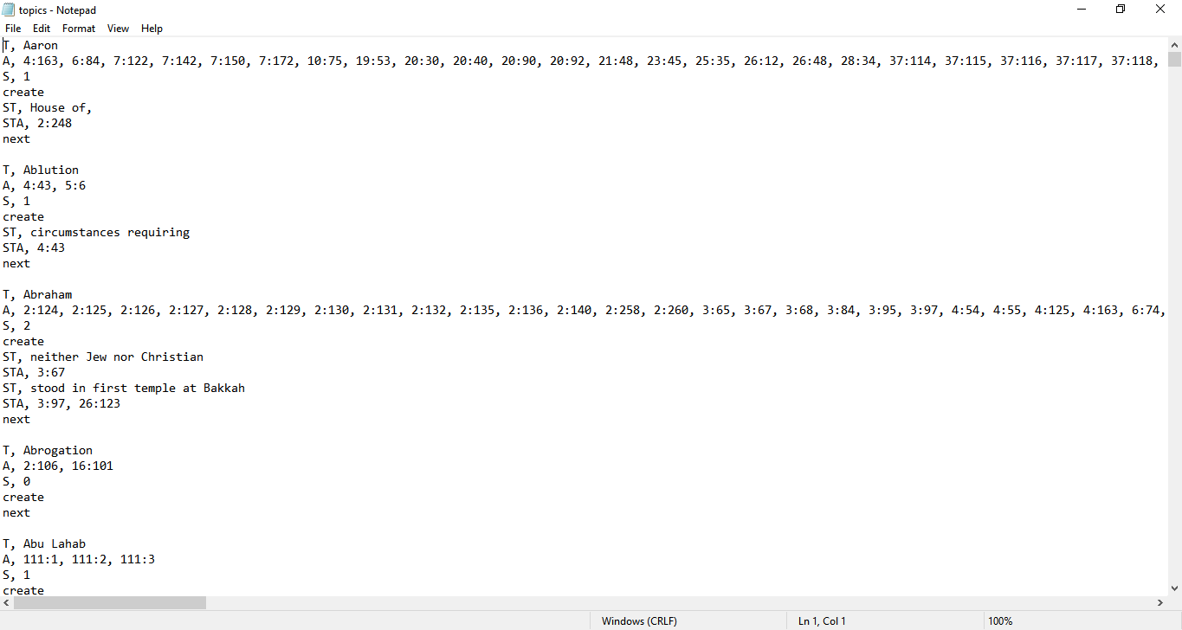
Topic Index
This unformatted version on the left was taken from the web and then formatted into the file on the left. T denotes topic name, A the related ayahs, S number of subtopics, “create” creates a object of topic, ST denotes name of subtopic, STA the ayahs related to subtopic and “next” initializes the variables again for next topic.

Slide 14
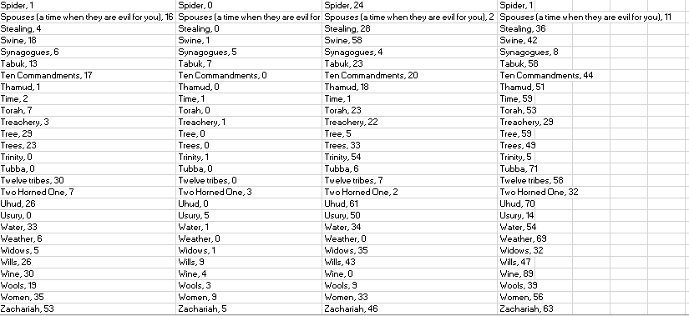
Analysis
Length = n+1/3n, non weighted ASCII
Length = n+1/3n, weighted ASCII
Length = n,
weighted ASCII
Length = n,
non weighted ASCII
The above table shows topic names with no of collisions and we can see we get the least number of collisions when using both weighted ASCII and array length of n+1/3n

Slide 15
THANKS
ANY QUESTIONS?

